Slide 1
Math 391:
Estimating Student GPA using Matrices In Python
Olivia Rueschhoff with Dr. Seyfi Turkelli

Slide 2
Introduction
Data was collected from Western Illinois University students anonymously using a Google Form.
The form asked participants to report their GPA, an overall satisfaction rating of Western Illinois University, as well as how many hours a day they spend on average sleeping, studying, socializing, and on their phone.

Slide 3
Goal
This data was then used to see if hours of sleep, studying, socializing, phone use and satisfaction rating could be used to accurately predict GPA

Slide 4
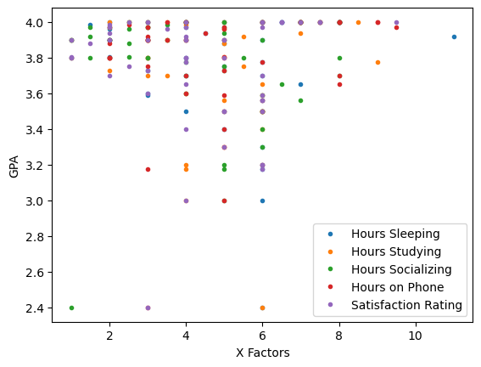
GPA Versus Variables
First a Matrix was constructed for all the observations to be used against the GPA. This was labeled as X Factors. Then the X Factors were plotted against their corresponding GPA to get a visualization of the data and if there’s any obvious correlation, which there is not that can be seen in the graph below.

Slide 5
The Matrix
Matrix of X [[ 8. , 8. , 8. , 8. , 7. ],
[ 8. , 8.5, 8. , 7. , 7. ],
[ 8. , 7. , 6. , 8. , 6.5],
[ 6.5, 5. , 7. , 8. , 9.5],
[ 7.5, 7. , 7. , 7. , 6. ],
[ 7. , 7. , 6. , 9. , 7.5],
[ 6.5, 7. , 6. , 9. , 6. ],
[ 4. , 7.5, 5. , 6. , 6.5],
[ 7.5, 2.5, 7. , 4. , 6.5],
[ 8. , 4. , 4. , 7.5, 2.5],
[ 4. , 2. , 4. , 4. , 3. ],
[ 2. , 3.5, 3. , 6. , 3. ],
[ 5. , 3. , 2.5, 3.5, 4. ],
[ 1.5, 4. , 3.5, 2.5, 2. ],
[ 3. , 2. , 5. , 5. , 4. ],
[ 2. , 3. , 1.5, 3. , 2. ],
[ 4. , 2. , 3. , 9.5, 6. ],
[ 2. , 5. , 2.5, 5. , 3.5],
[ 4.5, 7. , 5. , 4.5, 2. ],
[11. , 5.5, 1.5, 3. , 4. ],
[ 1. , 1. , 2. , 3. , 3. ],
[ 6. , 3. , 3. , 3. , 1. ],
[ 2. , 5. , 6. , 3. , 4. ],
[ 5. , 4. , 3.5, 4. , 5. ],
[ 2. , 3. , 2. , 2. , 2. ],
[ 4. , 3.5, 1. , 3.5, 5. ],
[ 5. , 5. , 2.5, 2. , 1.5],
[ 2. , 5. , 2.5, 5. , 1. ],
[ 1. , 3. , 3. , 2. , 1. ],
[ 4. , 1. , 5.5, 5. , 5. ],
[ 3. , 2. , 1.5, 2. , 4. ],
[ 2. , 3. , 8. , 2. , 4. ],
[ 6. , 9. , 4. , 6. , 4. ],
[ 5. , 5.5, 5. , 3. , 2.5],
[ 3. , 2. , 5. , 5. , 3. ],
[ 6. , 3. , 4. , 8. , 6. ],
[ 4. , 3.5, 8. , 4. , 2. ],
[ 7. , 6. , 6.5, 8. , 4. ],
[ 3. , 4. , 4. , 4. , 3. ],
[ 3. , 6. , 6. , 5. , 6. ],
[ 6. , 5. , 7. , 6. , 6. ],
[ 5. , 6. , 6. , 6. , 6. ],
[ 4. , 6. , 6. , 5. , 5. ],
[ 5. , 6. , 6. , 5. , 4. ],
[ 6. , 5. , 6. , 5. , 5. ],
[ 6. , 4. , 5. , 6. , 6. ],
[ 6. , 4. , 5. , 3. , 6. ],
[ 6. , 4. , 5. , 5. , 4. ],
[ 6. , 6. , 1. , 3. , 3. ] ] 49X5
The matrix used for this project is a 49x5 matrix where each row is one observation from students.

Slide 6
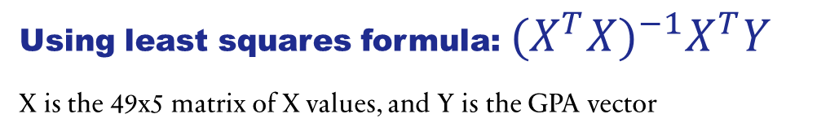
Using Python with Matrix Conversions
Using least squares formula: ${(X^{T}X)}^{−1}X^{T}Y$
X is the 49x5 matrix of X values, and Y is the GPA vector
beta = np.dot((np.dot(np.linalg.inv(np.dot(X_T,X)),X_T)),GPA)
Produces:
A 5 x1 matrix for each column
This gives the coefficients for each X variable by least squares regression.
array([[0.08436857], [0.18868691], [0.1942395 ], [0.19828581], [0.06177459]])

Slide 7
Using python to get A regression Table
To truly see the effect of the variables on GPA, a regression table is made, which can show
the coefficients of each variable,
a y-intercept value,
the R-squared value, and
give an equation to construct a residuals plot.

Slide 8
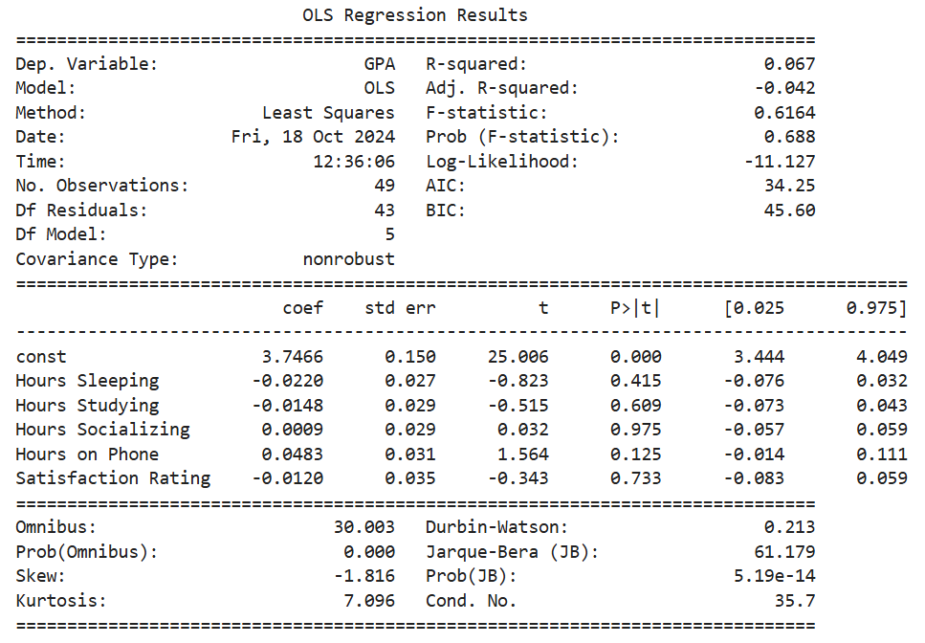
Regression Results Table
Including all variables

Slide 9
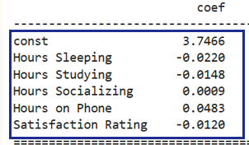
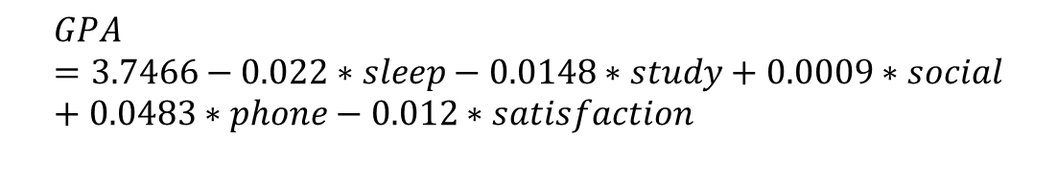
Table Results
The R-Squared value generated for the variables to predict GPA is 0.067, which is very small and close to 0.
  This indicated there is little to no correlation between all of the variables and GPA
Using the coefficients generated from the matrix, the following equation was constructed:
$$GPA=3.7466−0.022∗sleep−0.0148∗study+0.0009∗social+0.0483∗phone−0.012∗satisfaction$$

Slide 10
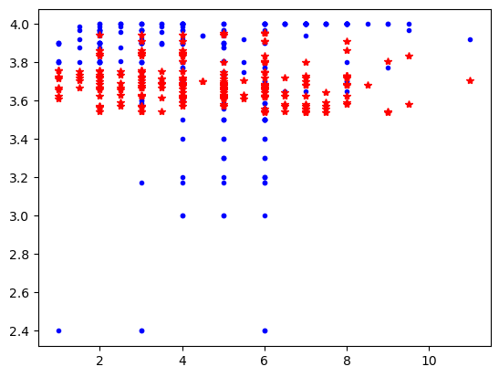

Comparing the Predicted GPA to the Actual GPA

Slide 11
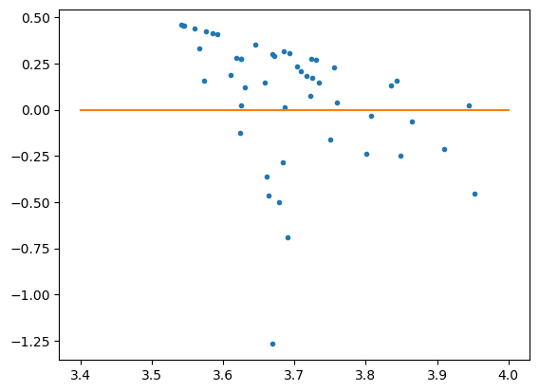
Residuals Plot
By subtracting the predicted GPA values from the actual GPA values, which is known as a residual, how far off the equation really is can be observed.
This residuals plot shows that the model made guessed the correct GPA within a range of 0 to 1.25. These residuals are significantly large considering that GPA is a relatively small and accurate value. An ideal model would have residuals very close to 0, unlike this one. Additionally, the table above provides an R-Squared value of 0.067. An ideal R-Squared value is 1 so this leads us to believe there is little to no correlation between these variables and GPA.

Slide 12
What now?
While the variables and GPA seemed to have little correlation and did not do a good job predicting GPA, curiosity took over and each variable was removed separately from the group to see if correlation would increase.
After looking at the previously made data table. It was thought that a variable might be weighing down the distribution, so each variable was removed and the correlation was rechecked. The phone variable was removed first to see if the correlation would increase.

Slide 13
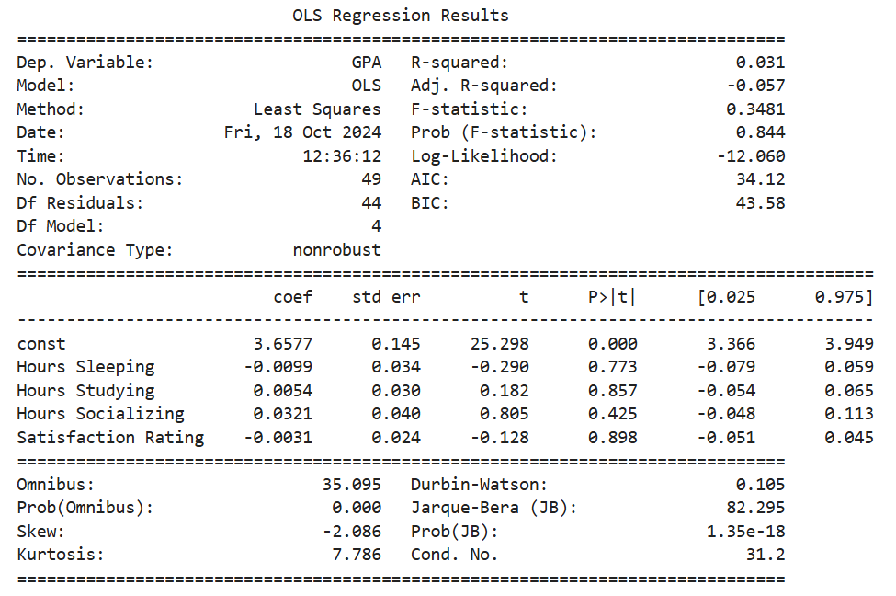
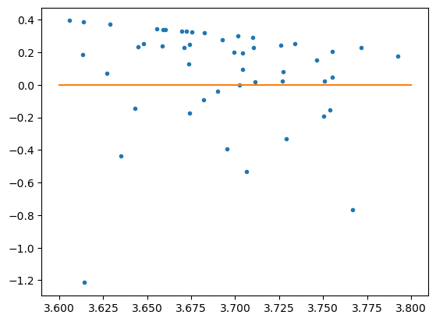
Regression Results Without Phone Variable
Equation: $GPA=3.6577−0.0099∗sleep+0.0054∗study+0.0321∗social−0.0031∗satisfaction$

Slide 14
What removing the phone variable showed
This residuals plot shows that the model made guessed the correct GPA within a range of 0 to 1.2. This suggests that removing the phone variable had little to no effect on the model. Additionally, the table above provides an R-Squared value of 0.031. Seeing as the phone variable reduced the R-Squared value suggests that it holds at least a little significance in predicting GPA.

Slide 15
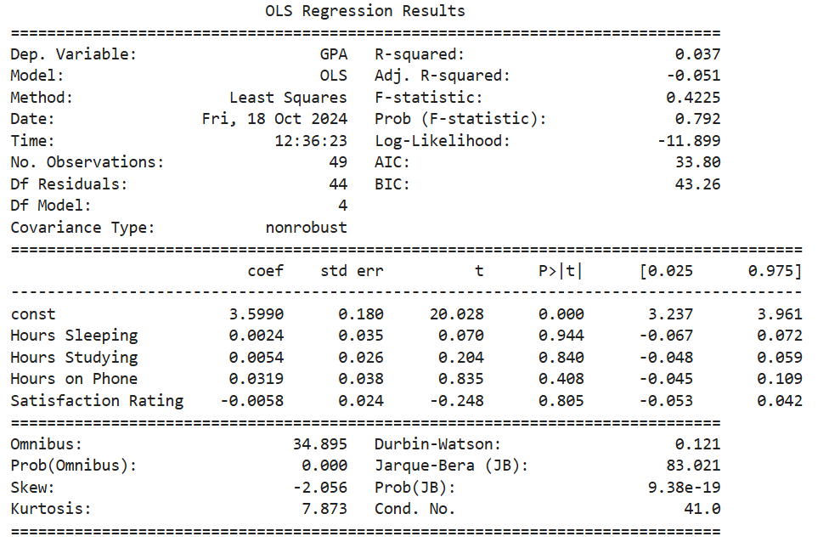
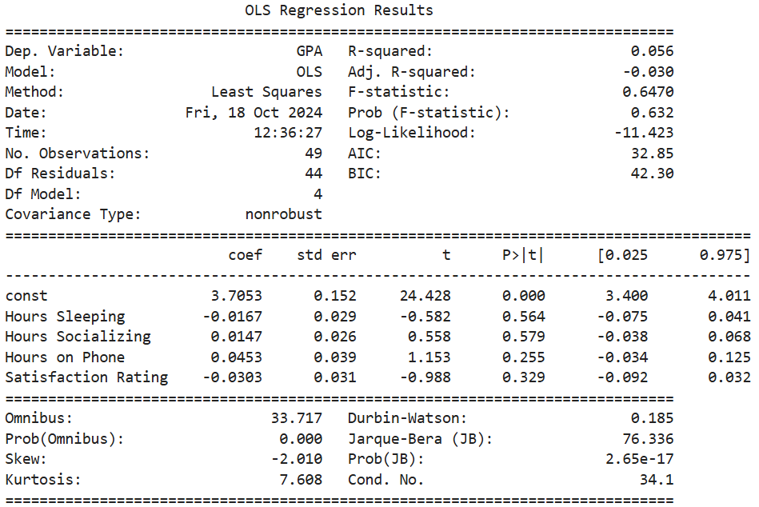
Removing Socializing, and Studying
Socializing Variable Removed Results
Study Variable Removed Results

Slide 16
What this could mean
The R-Squared value drop from the model that had all variables which suggests that socialization influences predicting student GPA to a degree
Interestingly, the R-Squared value still dropped when studying was removed, but not as significantly as when the other independent variables tested were removed. This suggests that while studying still influences GPA, it is not as much as socializing and phone.

Slide 17
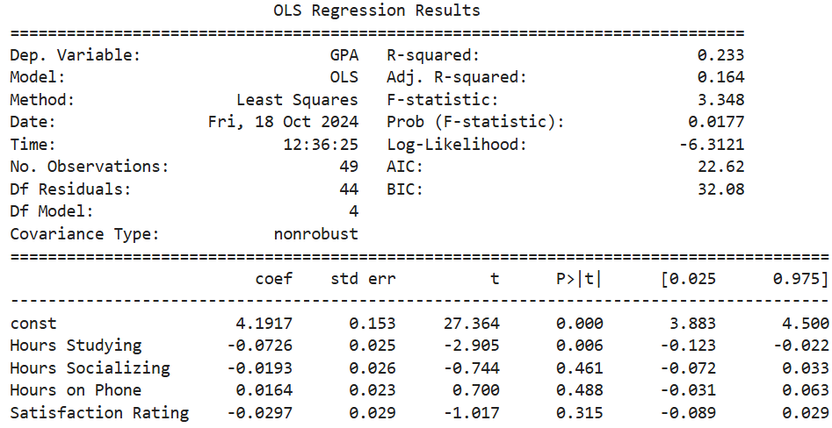
Removing the Sleep Variable

Slide 18
Interpretation of Removing Sleep Variable on Table
By removing the sleep variable from the data set caused the R-Squared value to jump dramatically from 0.067 to 0.233
While this value is still small, it does show that the sleep variable was weighing down the model and that there is no correlation of sleep to predicting student GPA.
In order to really see how removing the sleep variable impacted the matrix, the residuals were calculated and plotted.

Slide 19
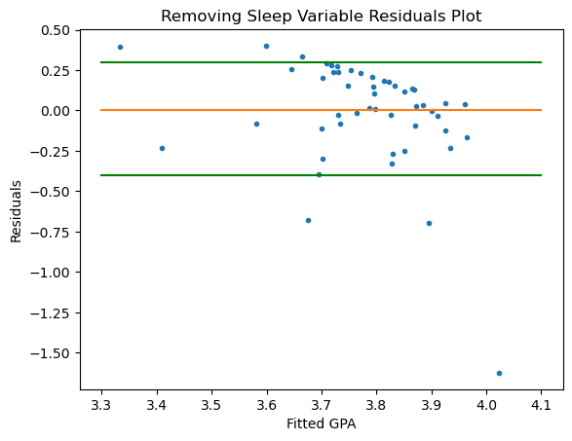
Residuals Plot for Visualization
With the sleep variable removed, aside from the obvious outlier, this residuals plot shows that the model made guessed the correct GPA within a range of 0 to 0.75. Most of the point closely hug the x-axis. This strengthens the idea that the sleep variable has no correlation to predicting GPA. And this could be the strongest model constructed to predict student GPA.
Equation: $GPA=4.1917−0.0726∗study−0.0193∗social+0.0164∗phone−0.0297∗satis$

Slide 20
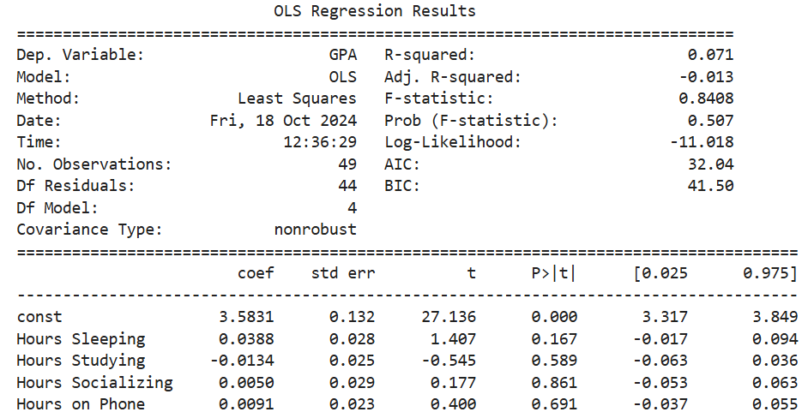
Removing the Satisfaction Rating Variable

Slide 21
Interpretation of Table
The removal of the satisfaction rating of the University caused the model's R-Squared value to slightly increase from 0.067 to 0.071. While it is still a very minor increase suggesting little to no correlation at all. This also could mean the satisfaction rating does not have a correlation with predicting GPA.
In order to really see how removing the satisfaction rating impacted the matrix, the residuals were calculated and plotted.

Slide 22
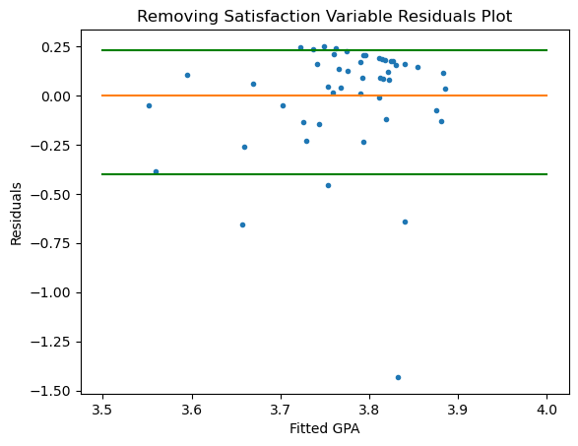
Residuals
Plot
With the satisfaction rating removed, despite the one obvious outlier, This residuals plot shows that the model made guessed the correct GPA within a range of 0 to 0.75. This strengthens the idea that the satisfaction variable has no correlation to predicting GPA.
Equation: $GPA=3.5831+0.0388∗sleep−0.0134∗study+0.005∗social−0.0091∗phone$

Slide 23
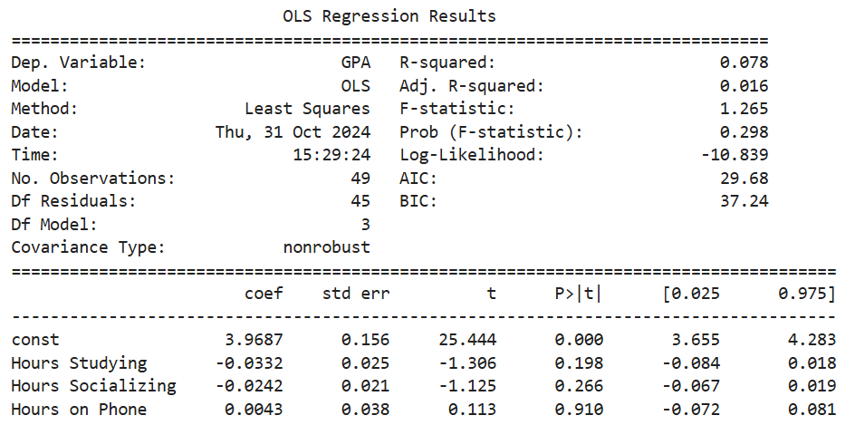
Removing the Sleep and Satisfaction Variable
Since removing both the sleep and satisfaction variable showed an increase in correlation individually, they were then both removed, and the model was reconstructed in hopes of getting the best model to predict student GPA.

Slide 24
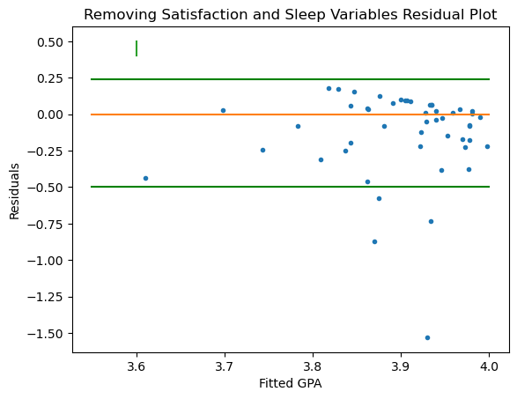
Surprising Table Results
The table shockingly shows an R-Squared value of 0.078. This value is very small and still suggests no correlation between the variables and GPA. This R-Squared value is surprising because it is less than that of when the sleep variable was removed by itself.
To truly visualize the difference between this model and the solely sleep variable removed model, the residuals were calculated and plotted.
Equation: $GPA=3.9687−0.0332∗study+0.0242∗social−0.0043∗phone$

Slide 25
Residual Plot Side-By-Side
These residual plots look very similar. They both have an extreme outlier, and several points close to the x-axis.
When both variables are removed there are less residuals above the x-axis creating a tighter appearance. This residuals plot
does however have several larger residuals below the x-axis compared to when the sleep variable is solely removed.
This suggests that despite the lower R-Squared value, removing both variables may produce a more accurate model to predict
GPA.

Slide 26
Using the Data To investigate more correlations

Slide 27
Predicting satisfaction from GPA and socialization
An interesting relationship to examine would be to see the impact of GPA and average hours spent socializing daily on university satisfaction rating.
It is thought that those with a higher GPA would likely be more satisfied with the university because they are more successful. Similarly, it is thought that those who spend a large amount of time socializing would be more satisfied with the university because of the connections they have made

Slide 28
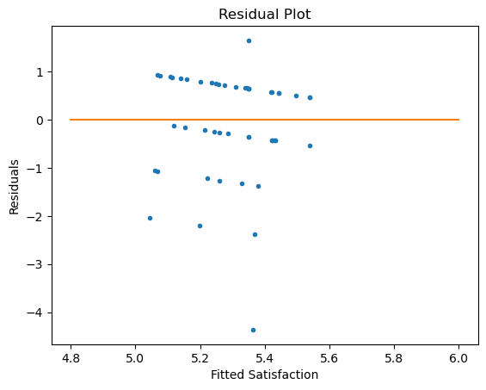
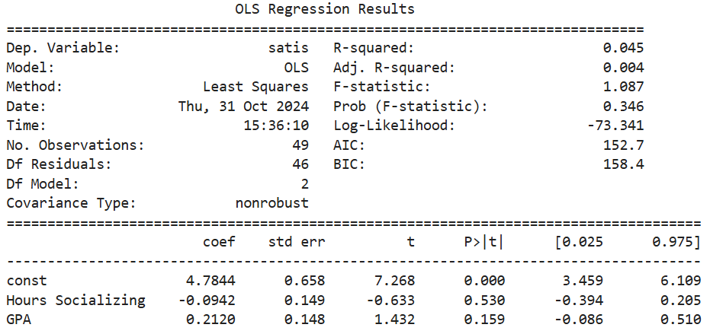
GPA and socializing to predict satisfaction Results

Slide 29
Interpretation
The R-Squared value is very small and close to 0. Additionally, the residuals plot is far from the x-axis which means none of the satisfaction data was accurately predicted by the model. This suggests GPA and socialization are not correlated to the university satisfaction rating and can not be used to accurately predict satisfaction as well.

Slide 30
What about just satisfaction and socialization?

Slide 31
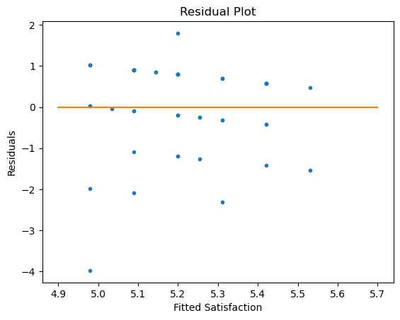
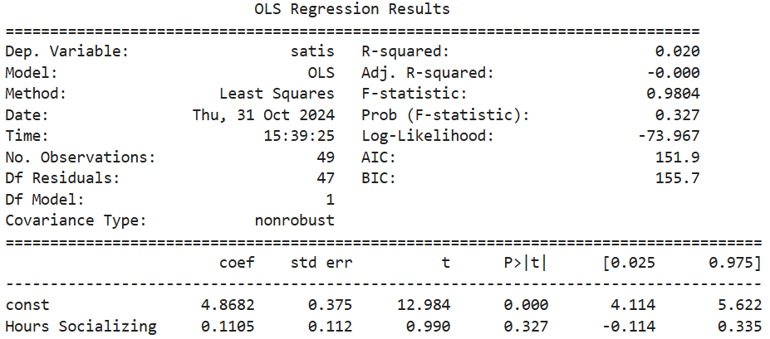
Socializing to Predict satisfaction results

Slide 32
Interpretation
This R-Squared value dropped by 0.025, which is over half, from the previous model, and is very close to 0 at 0.02 Additionally, the residuals plot is slightly better than when it was both GPA and socialization, but only one of the satisfaction data was accurately predicted by the model that was created. This suggests socialization is not correlated to the university satisfaction rating and can not be used to accurately predict satisfaction.

Slide 33
What about GPA and Satisfaction Rating?

Slide 34
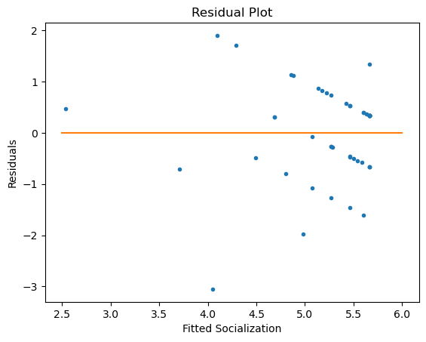
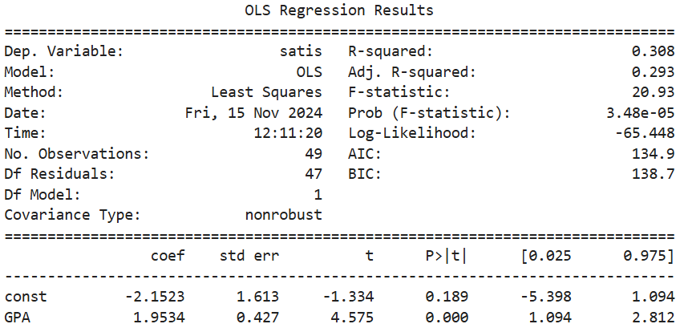
Using GPA to predict Satisfaction Rating

Slide 35
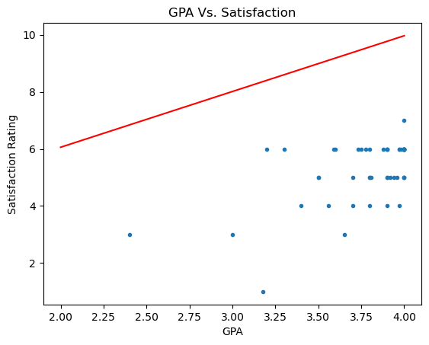
Interpretation
The R-Squared value is the greatest calculated thus far, suggesting the relationship solely between GPA and Satisfaction Rating is slightly strong, however it is still small at 0.308 as about 70% of the data goes unexplained. The residuals plot also appears very spread. GPA was plotted again Satisfaction rating to see just how close the shape of the model is to the points, and it looks very far off. This still supports the idea that they should not be used to try and accurately predict one another.

Slide 36
What about GPA and socialization?

Slide 37
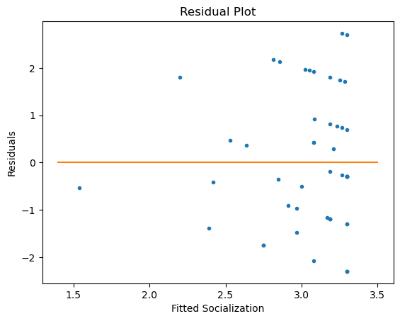
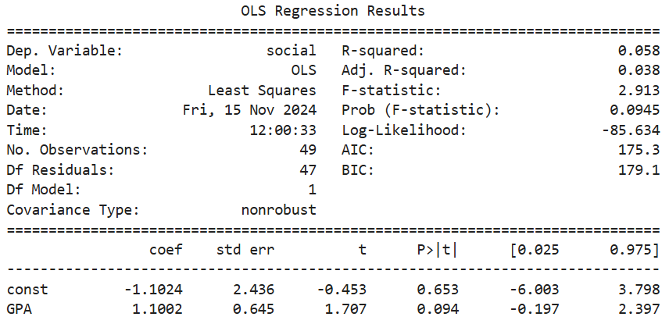
Using GPA to predict Socialization

Slide 38
Interpretation
Once again, the R-squared value is tiny and suggests there is little to no correlation between GPA and socialization. The residuals plot supports this as it has a very large spread as it greatly over and underestimates average hours spent socializing. Therefore, this model can not accurately predict Socialization from GPA.

Slide 39
Possible errors
The results could likely be skewed due to the possibility of several errors occurring. The most significant error would be in the student reporting. It is likely people could’ve been inaccurate in their responses. It is also important to note that the sample of student taken was not random, it was sent out to many students (most of which were honors students based on availability) and done optionally. It is also important to note that several first semester freshmen filled out the form so they likely indicated they had a 4.0 GPA when it will probably change during college. The same thing applies to their satisfaction rating.

Slide 40
Conclusion
Therefore, we can conclude, while none of these models are very good, meaning GPA is unlikely to be accurately predicted from the variables used, but we can still observe that all of them except sleep and satisfaction rating had some impact, though not significant, on GPA.

Slide 41
Conclusion
Similarly, we can conclude, that there is no relationship between GPA and satisfaction rating as well as socialization and satisfaction rating. While there is no correlation, we can still take away that a student’s rating of their satisfaction with the university must stem from many more factors and differs from student to student.

Slide 42
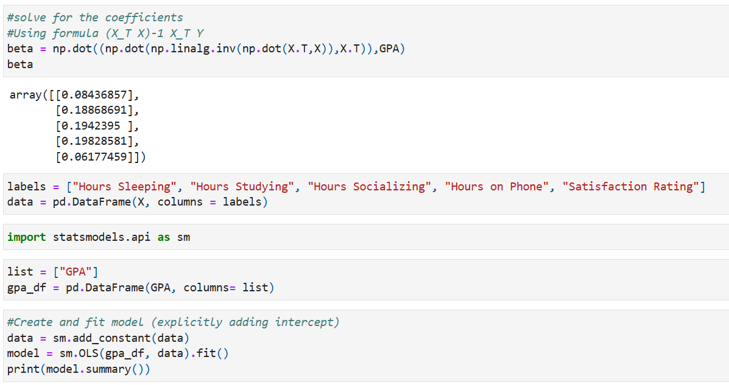
Some of the Python Code used in this project
For all of the code done for this project click here

